Slide 1
LAN Connections
Constructing a Network Addressing Scheme

Slide 2
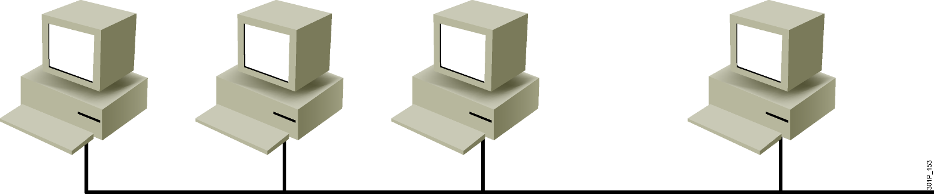
Flat Topology
Problems
  All devices share the same bandwidth.
  All devices share the same broadcast domain.
  It is difficult to apply a security policy.
Notes:
Lesson Aim
<Enter lesson aim here.>

Slide 3
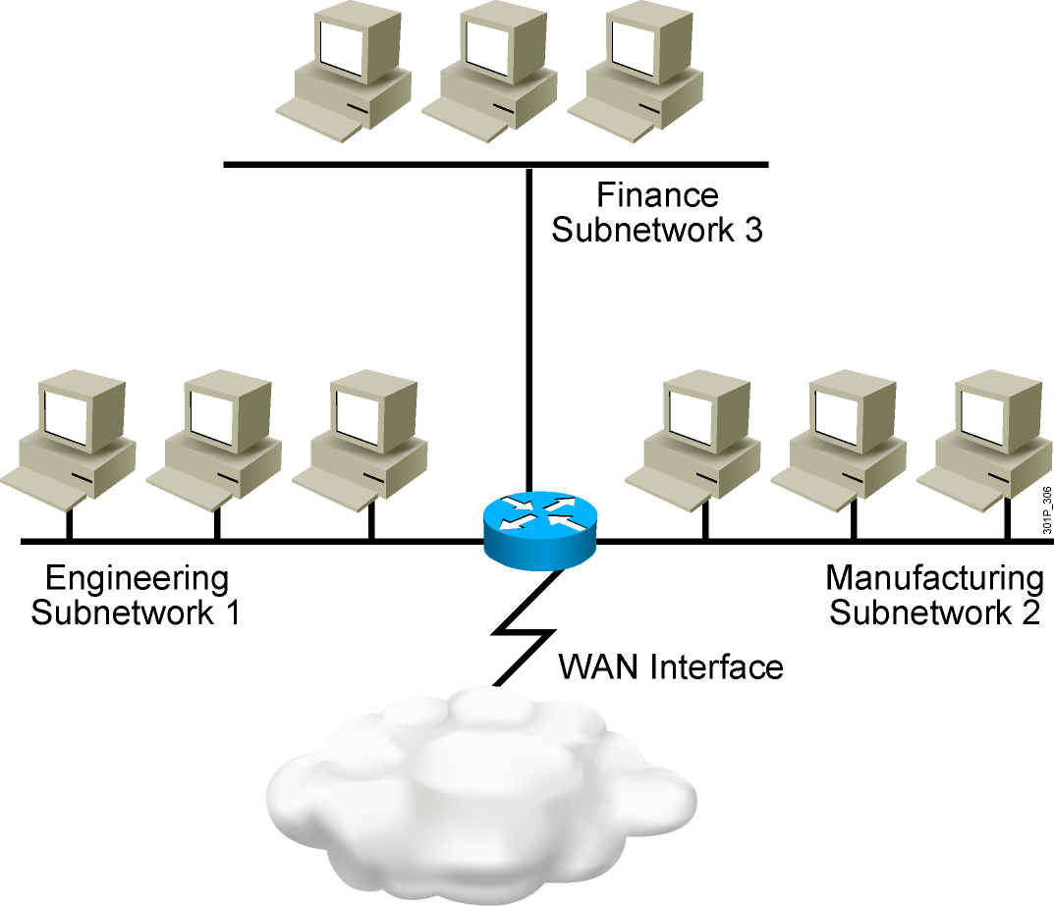
Subnetworks
  Smaller networks are easier to manage.
  Overall traffic is reduced.
  You can more easily apply network security policies.
Notes:
Lesson Aim
<Enter lesson aim here.>

Slide 4
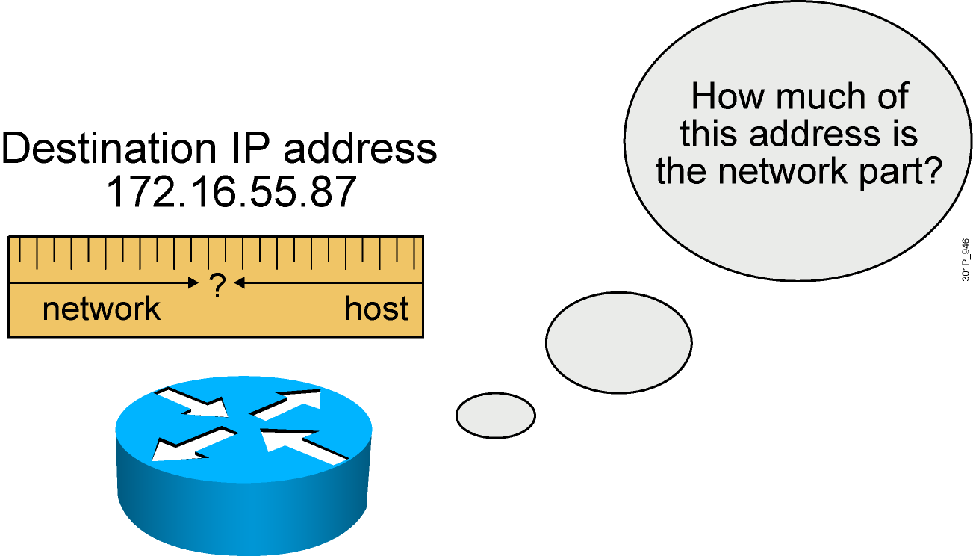
What a Subnet Mask Does
  Tells the router the number of bits to look at when routing
  Defines the number of bits that are significant
  Used as a measuring tool, not to hide anything

Slide 5
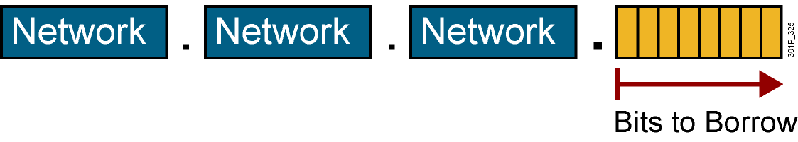
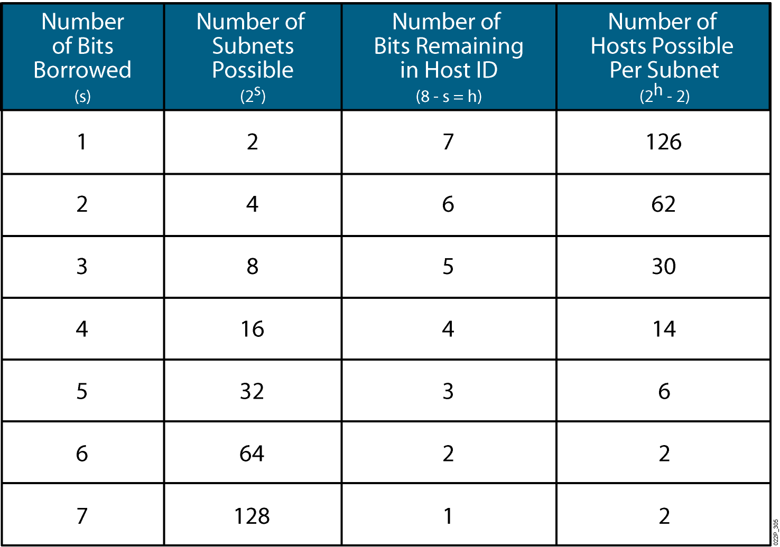
Possible Subnets and Hosts for a Class C Network

Slide 6
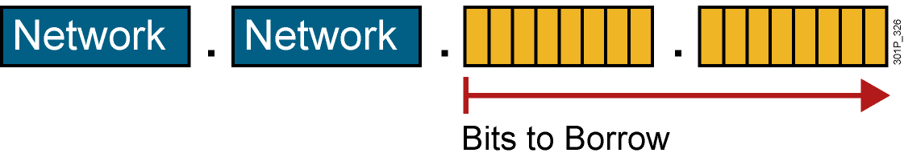
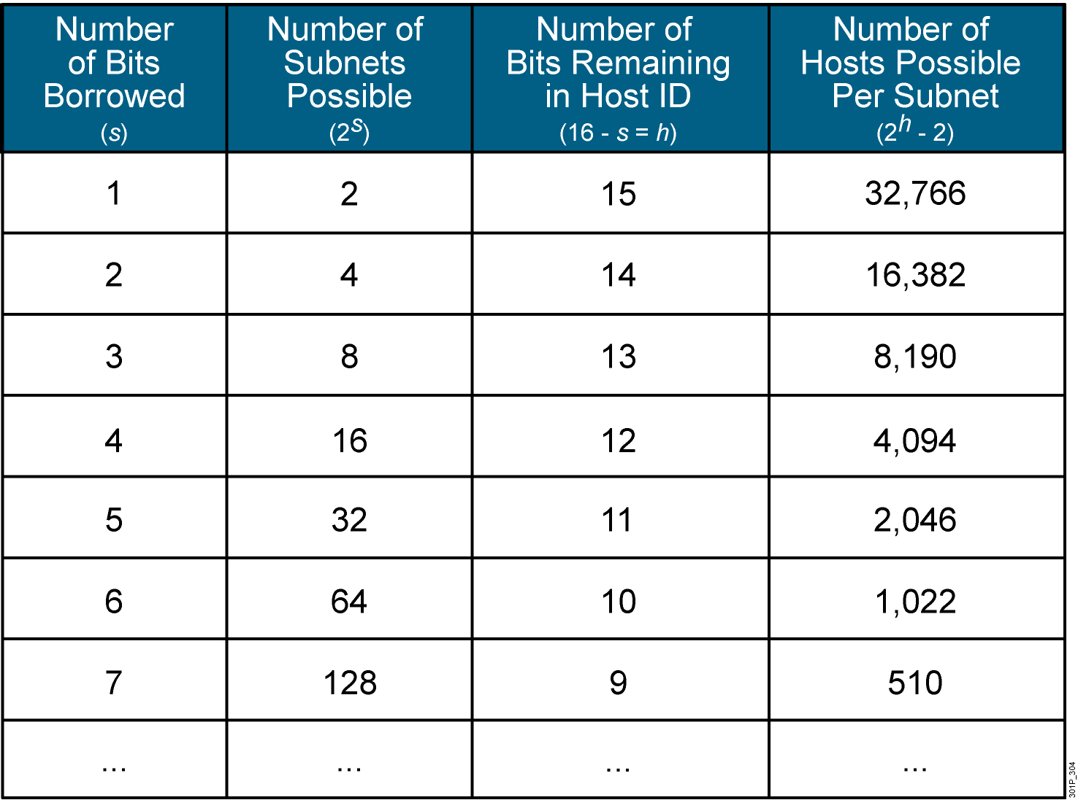
Possible Subnets and Hosts for a Class B Network

Slide 7
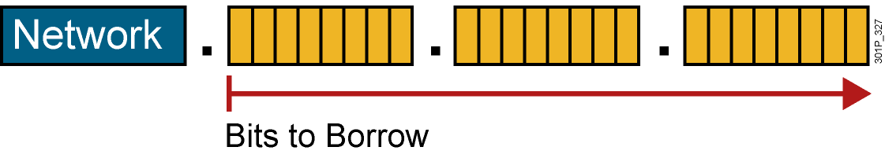
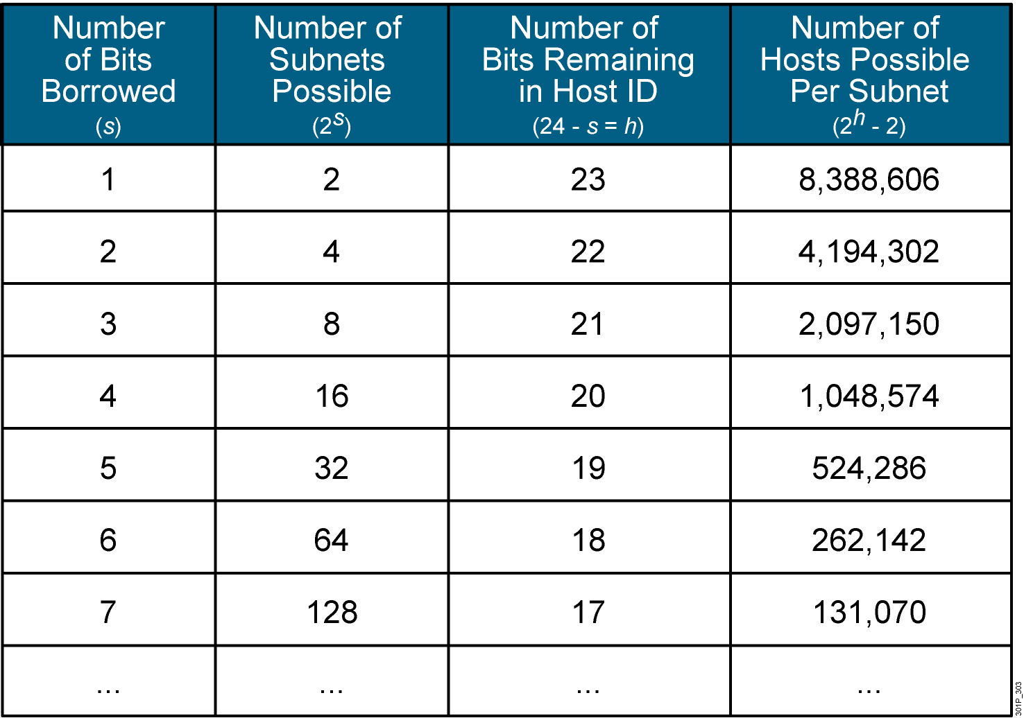
Possible Subnets and Hosts for a Class A Network

Slide 8
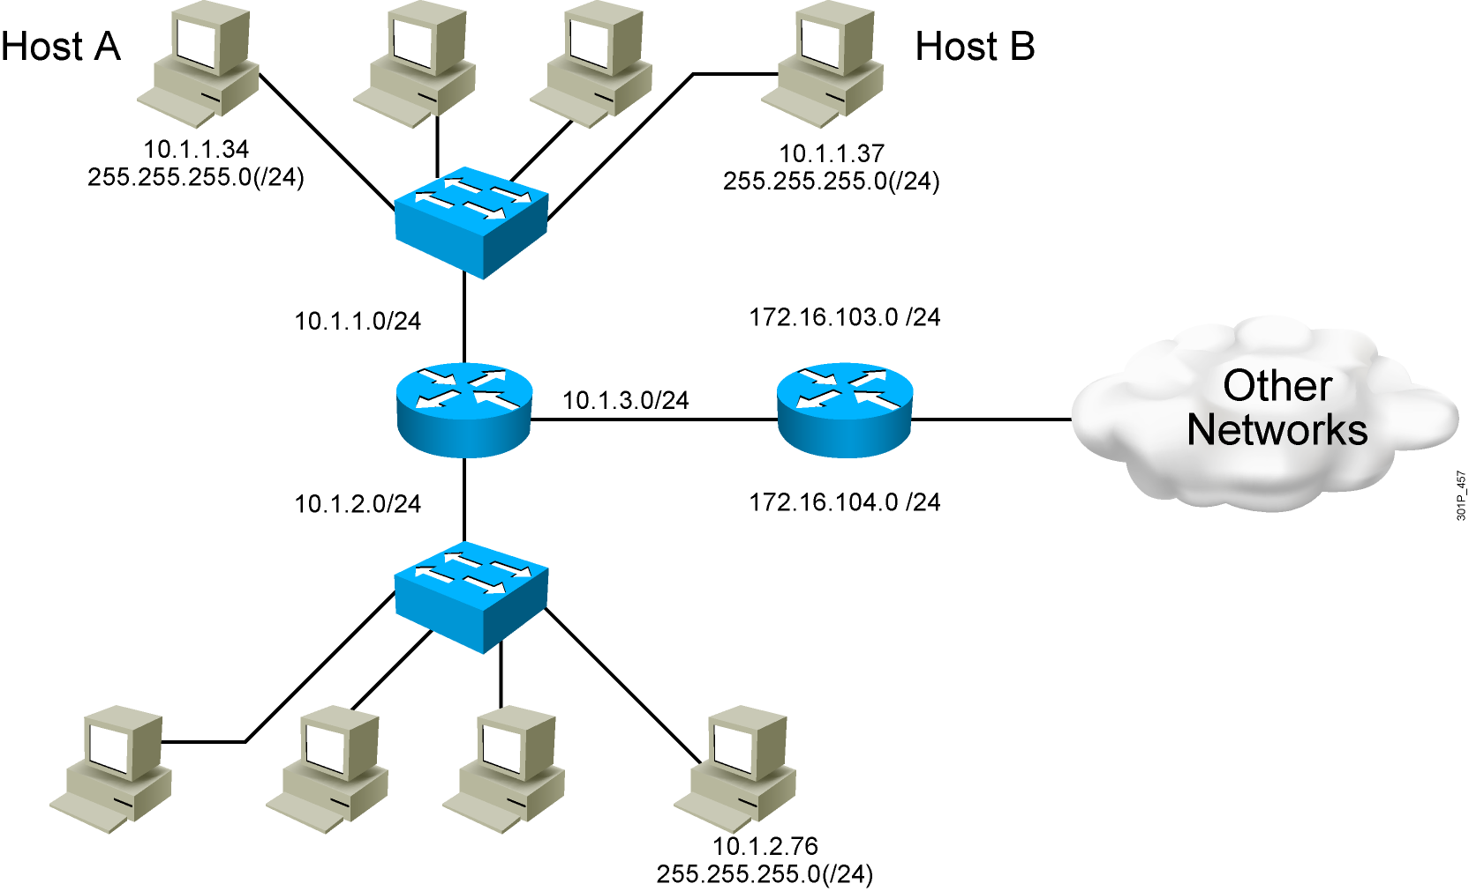
End System Subnet Mask Operation

Slide 9
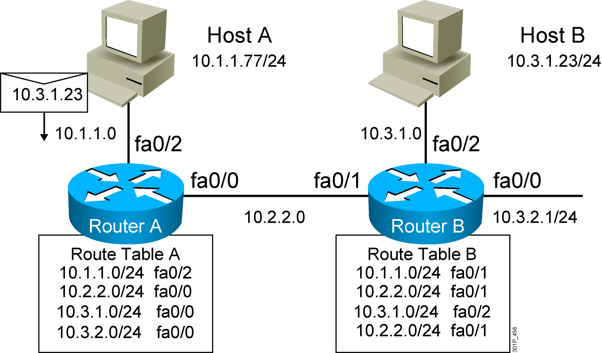
How Routers Use Subnet Masks

Slide 10
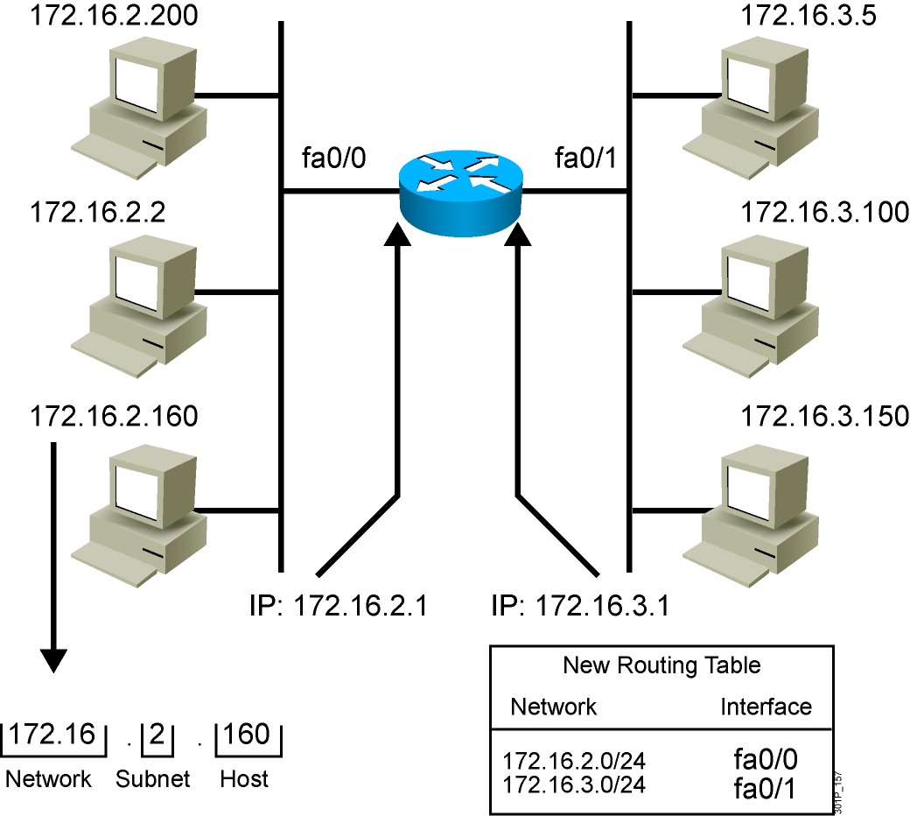
Applying the Subnet Address Scheme
Notes:
Lesson Aim
<Enter lesson aim here.>

Slide 11
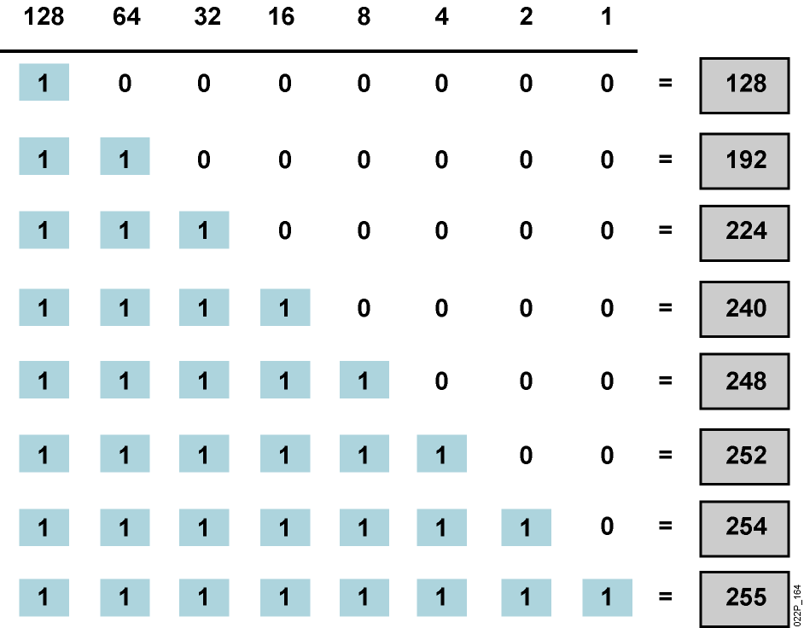
Octet Values of a Subnet Mask
Subnet masks, like IP addresses, are represented in the dotted decimal format like 255.255.255.0

Slide 12
Default Subnet Masks
Example Class A address (decimal): 10.0.0.0
Example Class A address (binary): 00001010.00000000.00000000.00000000
Default Class A mask (binary): 11111111.00000000.00000000.00000000
Default Class A mask (decimal): 255.0.0.0
Default classful prefix length: /8
Example Class B address (decimal): 172.16.0.0
Example Class B address (binary): 10010001.10101000.00000000.00000000
Default Class B mask (binary): 11111111.11111111.00000000.00000000
Default Class B mask (decimal): 255.255.0.0
Default classful prefix length: /16
Example Class C address (decimal): 192.168.42.0
Example Class C address (binary): 11000000.10101000.00101010.00000000
Default Class C mask (binary): 11111111.11111111.11111111.00000000
Default Class C mask (decimal): 255.255.255.0
Default classful prefix length: /24

Slide 13
Procedure for Implementing Subnets
  Determine the IP address assigned by the registry authority.
  Based on the organizational and administrative structure, determine the number of subnets required.
  Based on the address class and required number of subnets, determine the number of bits you need to borrow from the host ID.
  Determine the binary and decimal value of the subnet mask.
  Apply the subnet mask to the network IP address to determine the subnet and host addresses.
  Assign subnet addresses to specific interfaces.

Slide 14
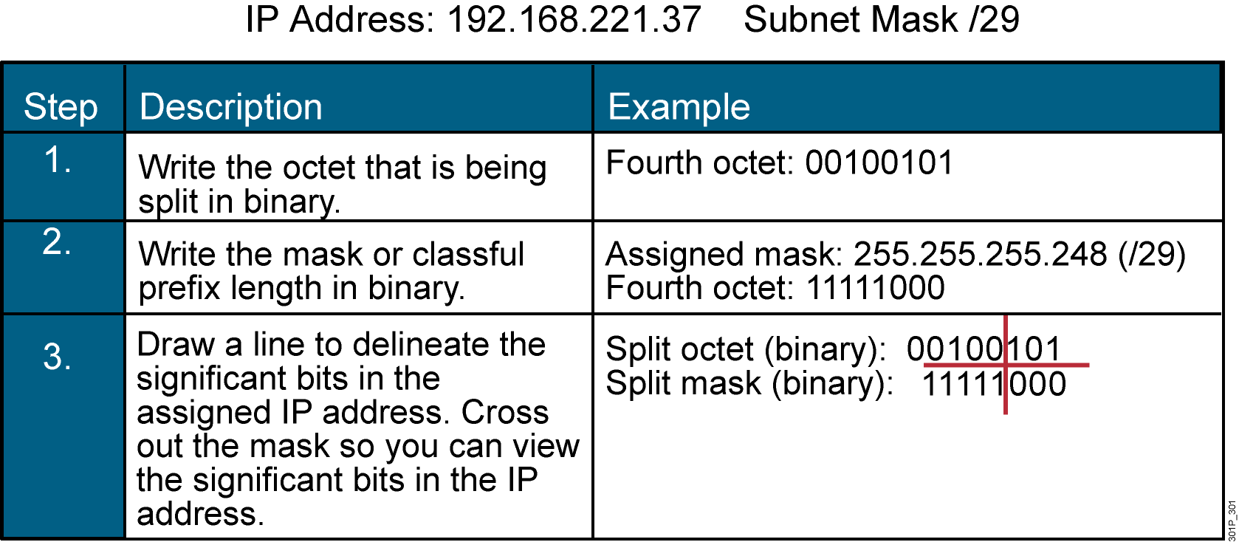
Eight Easy Steps for Determining Subnet Addresses

Slide 15
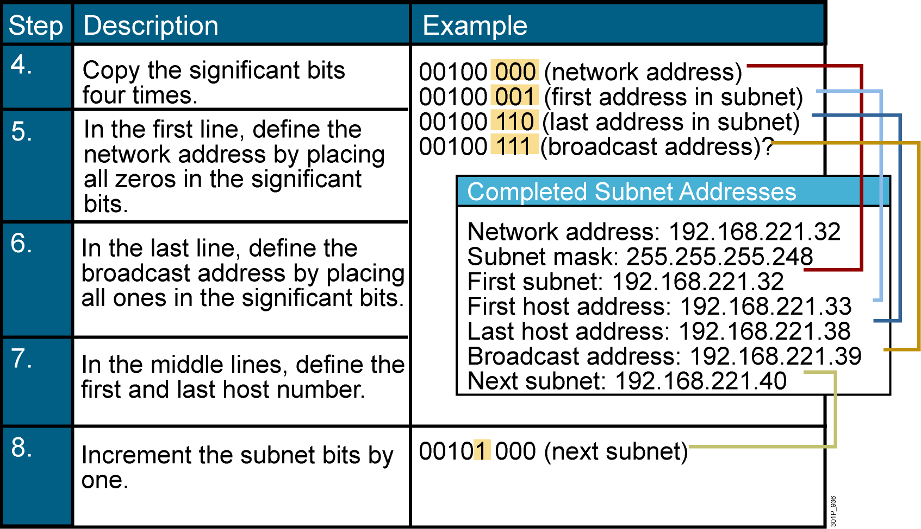
Eight Easy Steps for Determining Subnet Addresses (Cont.)

Slide 16
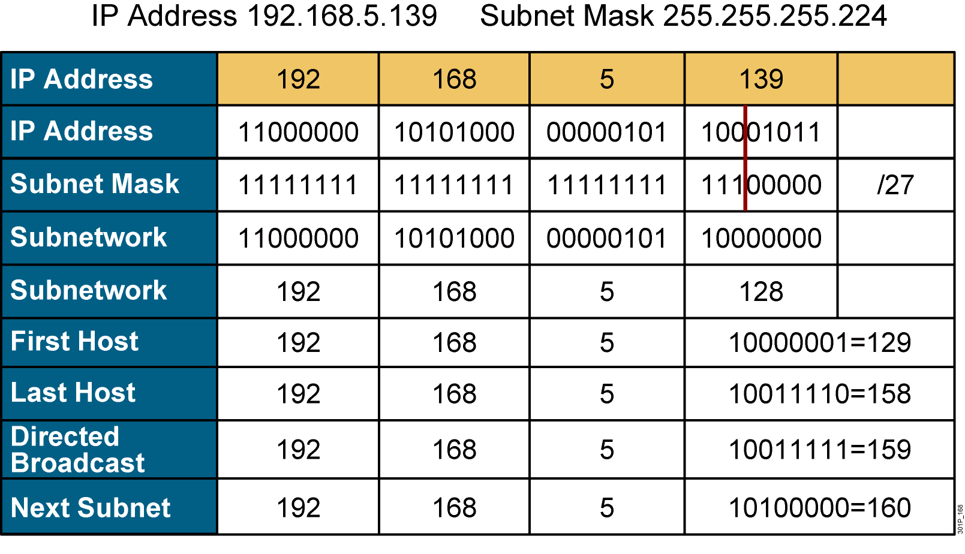
Example: Applying a Subnet Mask for a
Class C Address

Slide 17
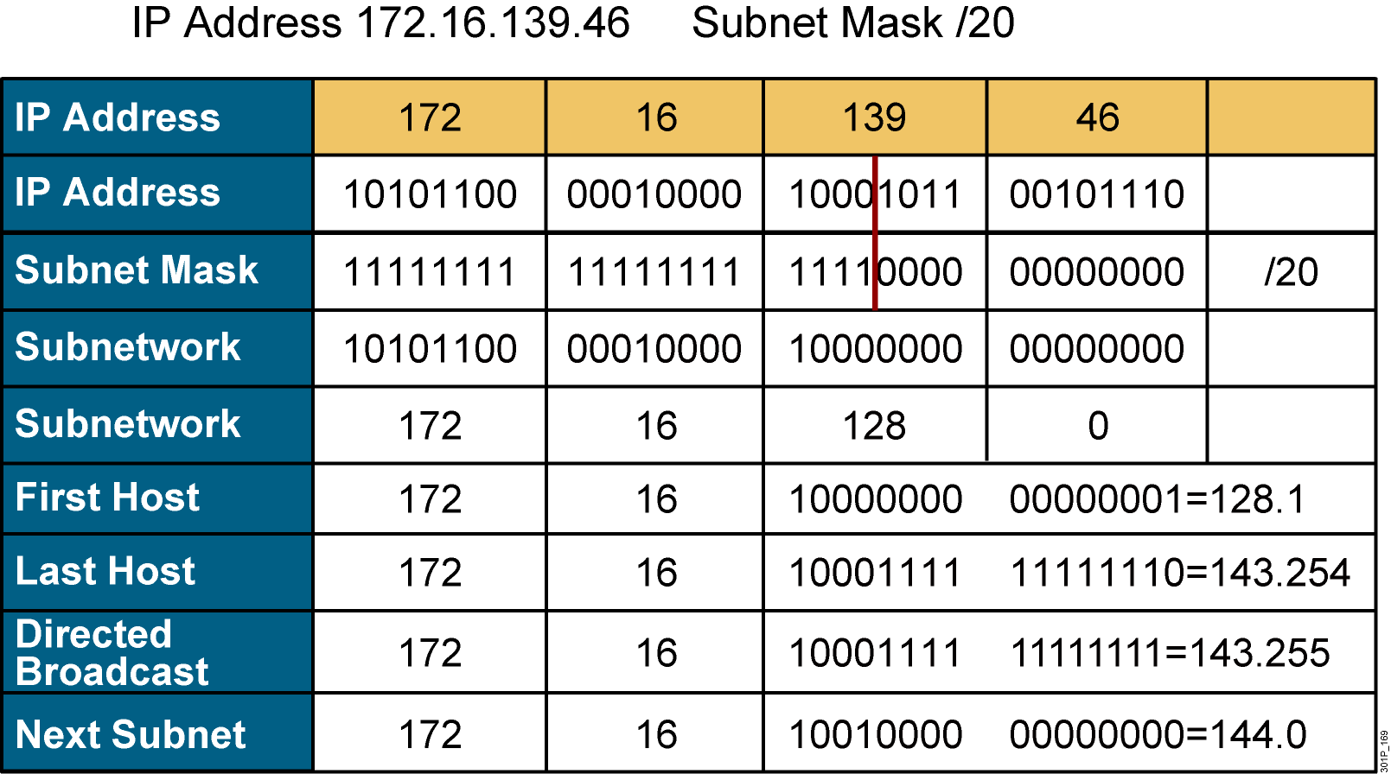
Example: Applying a Subnet Mask for a
Class B Address

Slide 18
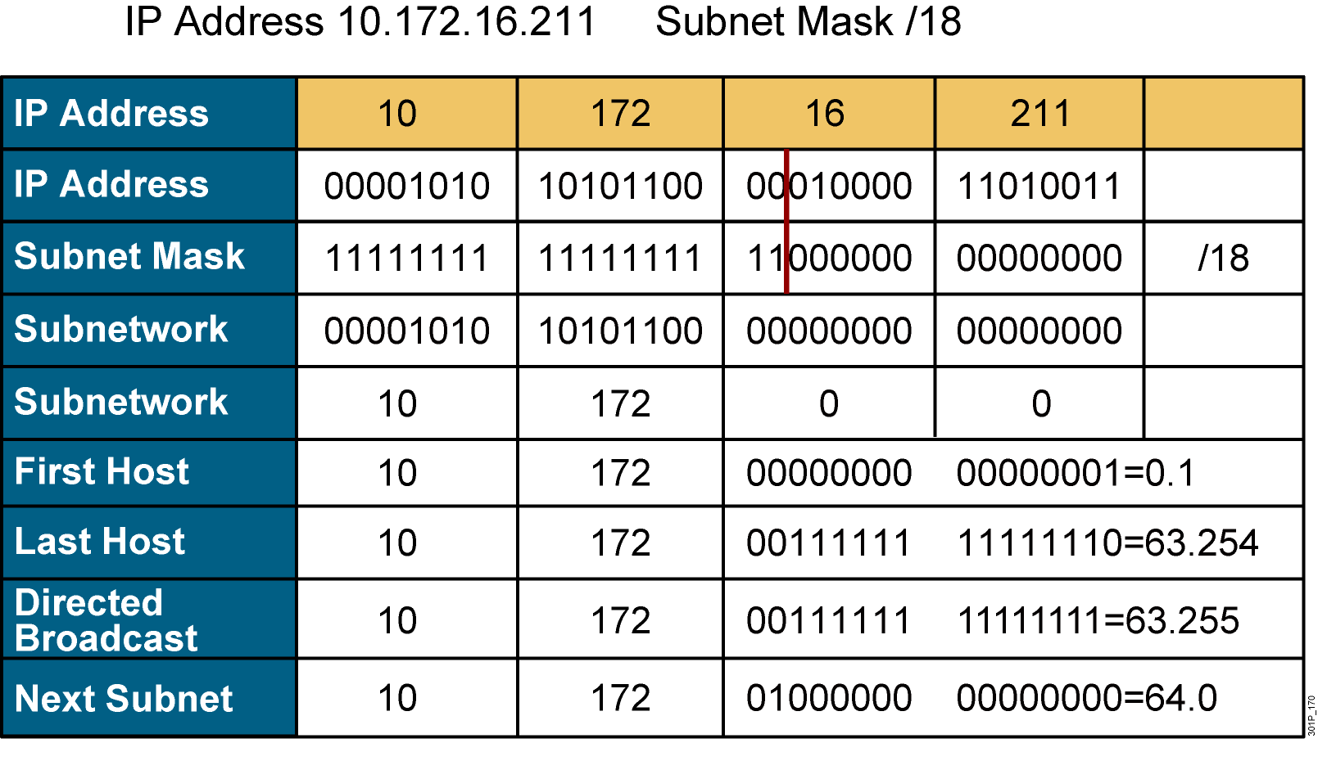
Example: Applying a Subnet Mask for a
Class A Address

Slide 19
Summary
  Networks, particularly large networks, are often divided into smaller subnetworks, or subnets. Subnets can improve network performance and control.
  A subnet address extends the network portion, and is created by borrowing bits from the original host portion and designating them as the subnet field.
  Determining the optimal number of subnets and hosts depends on the type of network and the number of host addresses required.
  The algorithm for computing a number of subnets is 2^{s}, where s is the number of subnet bits.

Slide 20
Summary (Cont.)
  The subnet mask is the tool that the router uses to determine which bits are routing (network and subnet) bits and which bits are host bits.
  End systems use subnet masks to compare the network portion of the local network addresses with the destination addresses of the packets to be sent.
  Routers use subnet masks to determine if the network portion of an IP address is on the corresponding routing table or if the packet needs to be sent to the next router.

Slide 21
Summary (Cont.)
Follow these steps to determine the subnetwork and host addresses using a subnet mask:
  Write the octet being split in binary.
  Write the mask in binary and draw a line to delineate the significant bits.
  Cross out the mask so you can view the significant bits.
  Copy the subnet bits four times.
  Define the network address by placing all zeroes in the
  host bits.
  Define the broadcast address by placing all ones in the
  host bits.
  Define the first and last host numbers.
  Increment the subnet bits by one.

